Slide 1
Step I : Product Selection

Slide 2
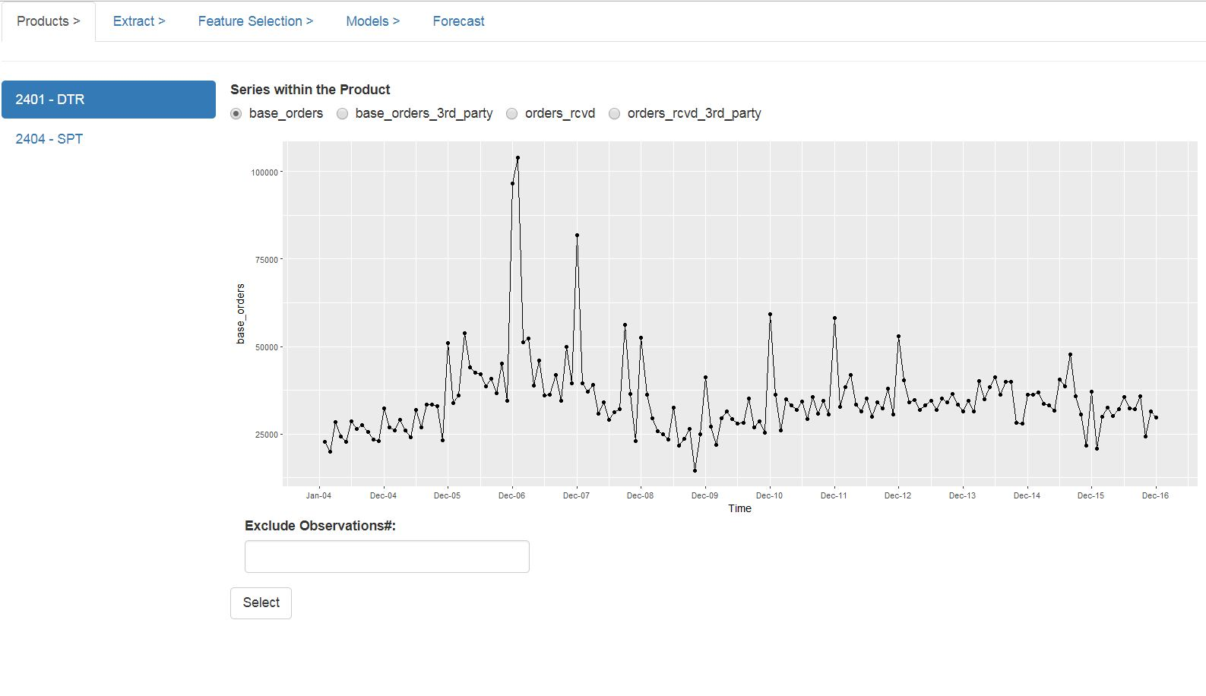
Step 2: Select the revenue type
Step 3 [Optional] : Select observations to be excluded by
clicking on the data points. Such points
would be listed in the “exclude observations#”
box.
Step 1: Select Product
Line
Step 4: Finalize the selection

Slide 3
Step II : Extract Data

Slide 4
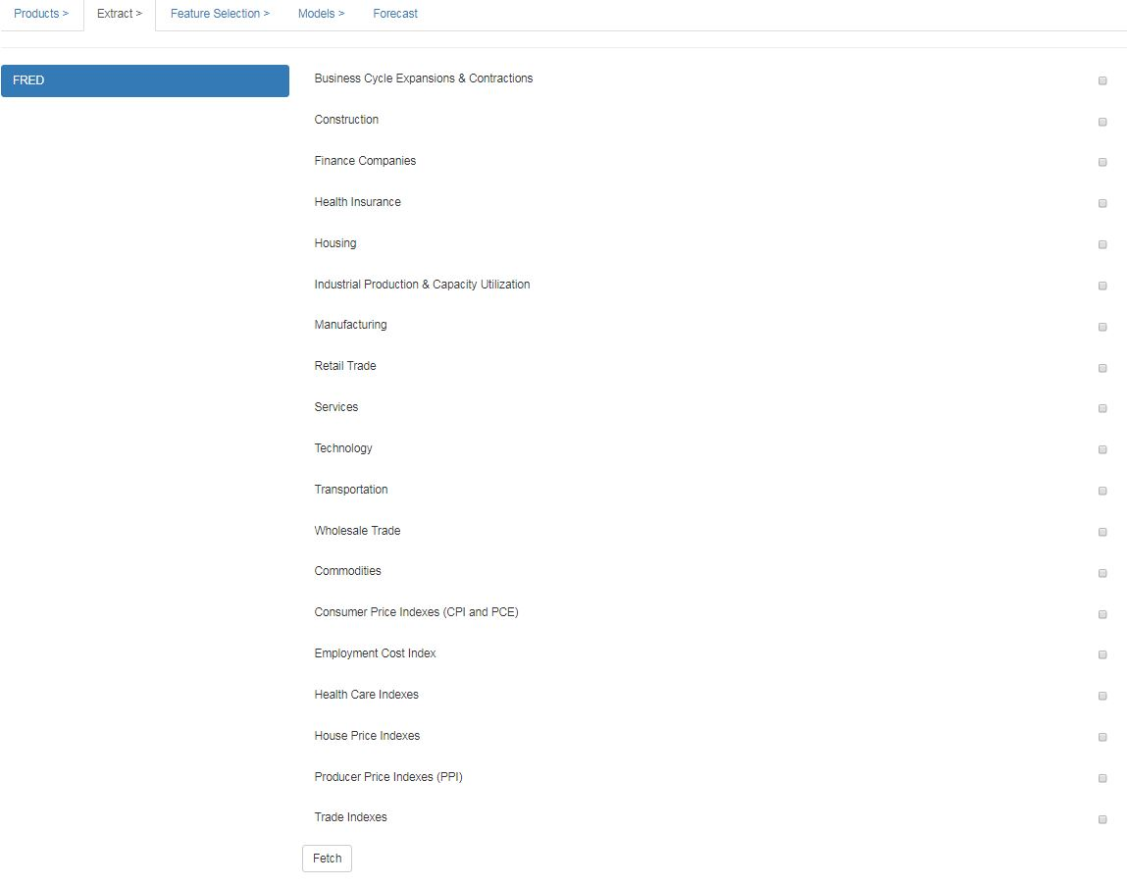
Step 1: Select the
subcategories that
needs to be fetched
NOTE: The steps in this tab can be
skipped if the external data has been
fetched and stored in the local system.
Step 2: Click to Fetch the selected sub-categories. It takes a while to fetch them.

Slide 5
Step III : Feature Selection

Slide 6
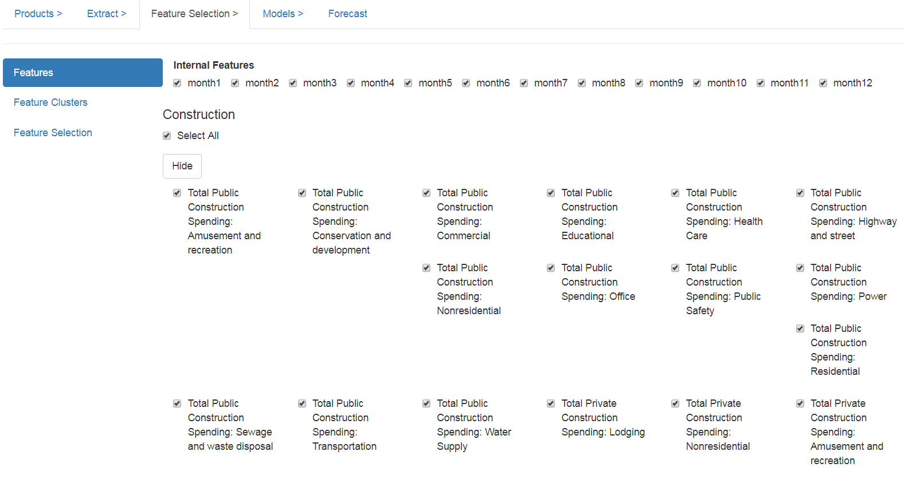
Select/Unselect the
required features to be
considered.

Slide 7
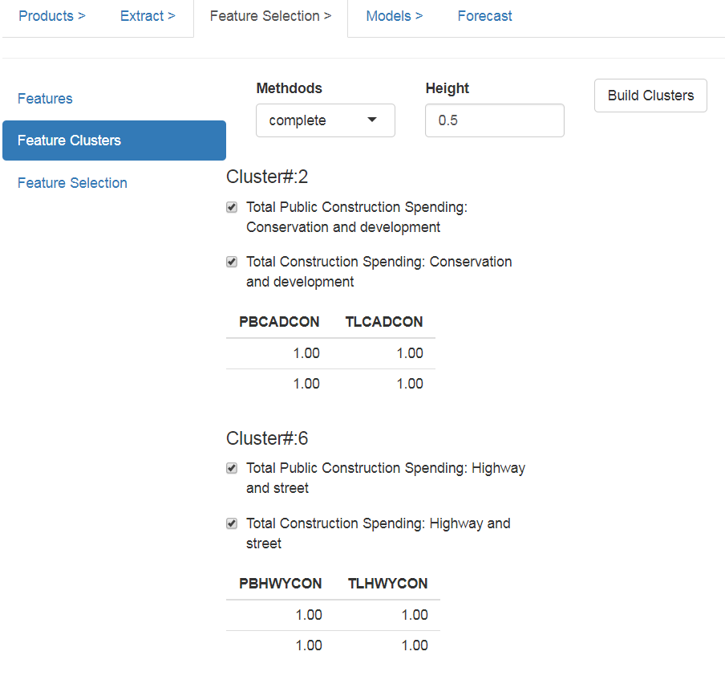
Select one features from each cluster.
Clusters are formed based on correlation.
If this not selected, the feature selection
algorithm selects one randomly from each
cluster

Slide 8
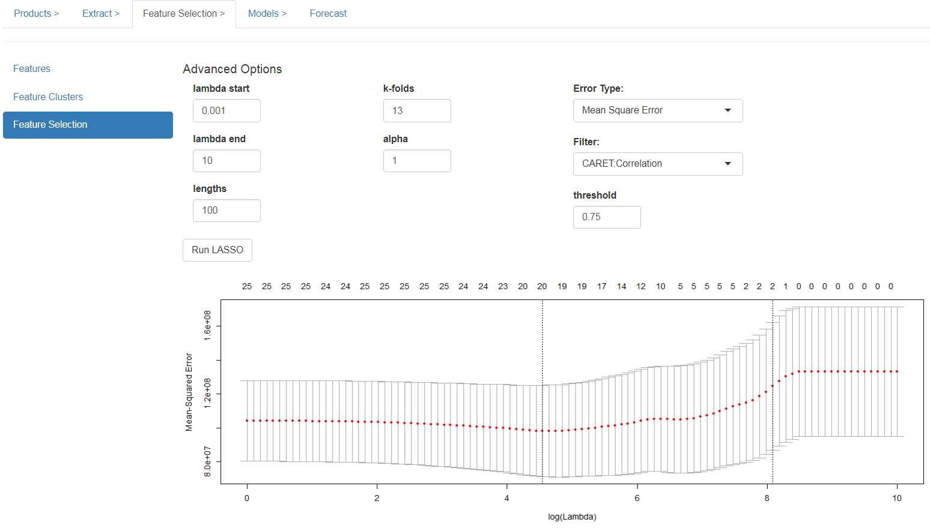
Step 1: Click to perform
LASSO
feature selection
The LASSO model selects two model
Best Model : the model with the lowest error
Simple Model : the model within 1Std.Dev error of the best model, usually has lower number of features in the model

Slide 9
Step IV : Building Models & Benchmark

Slide 10
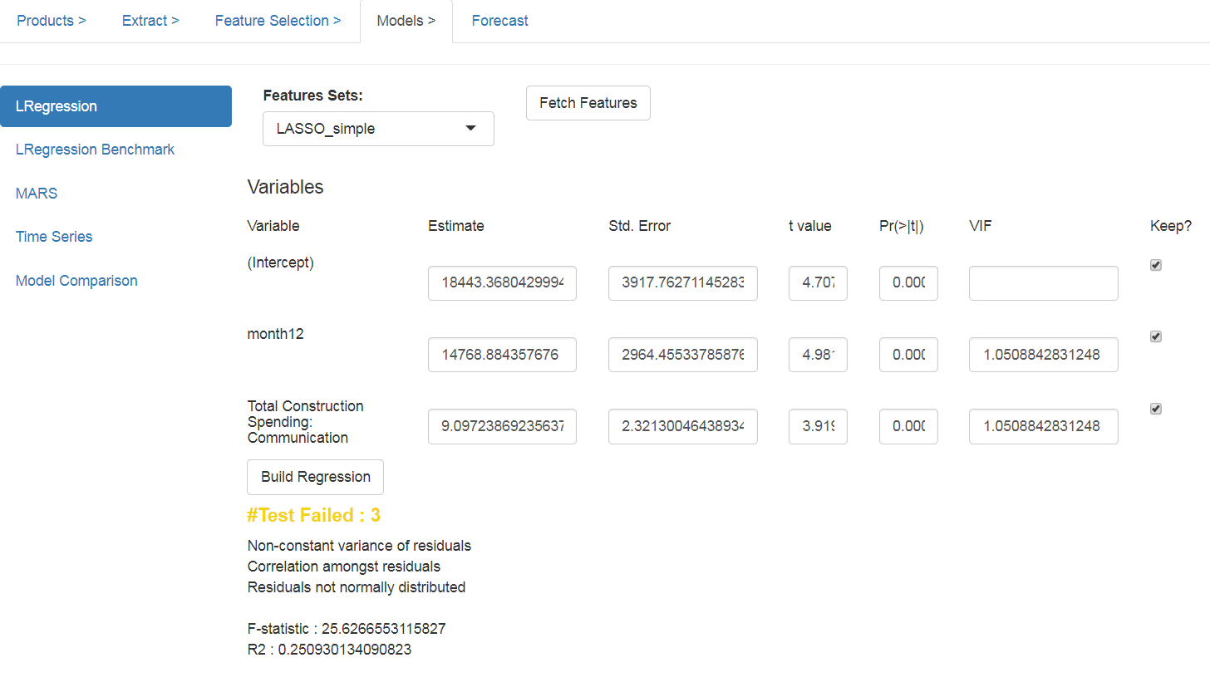
Step 1: Select the set of feature [Best/Simple] of LASSO,
which has to used for building regression model .
Click “Fetch Features” to populate them below.
Step 2: Click “Build Regression” to build linear regression model
using the selected features. If any of the tests fails, analyze
the plots below.
Feature can be unselected, if they violate any model
assumption. Do re-run the LASSO, after un-selection

Slide 11
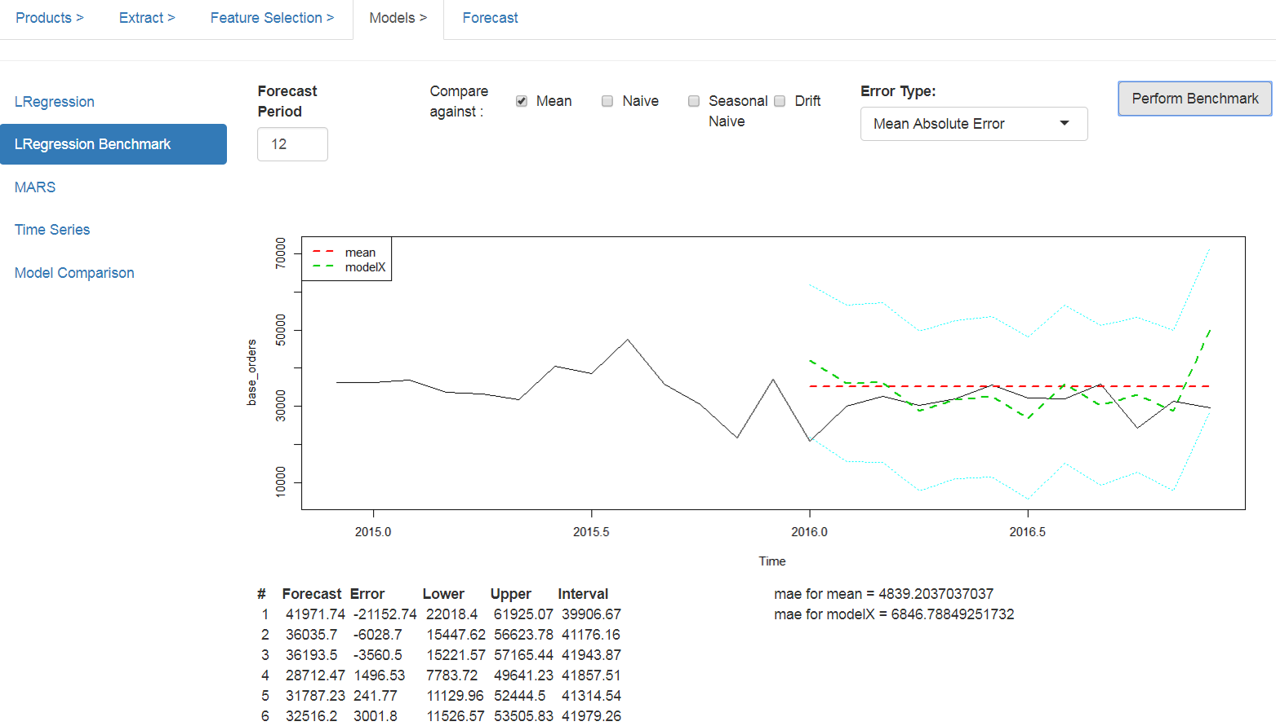
^ Methods to compare the linear model against
Error metrics for selected models
Forecast from
Linear Regression

Slide 12
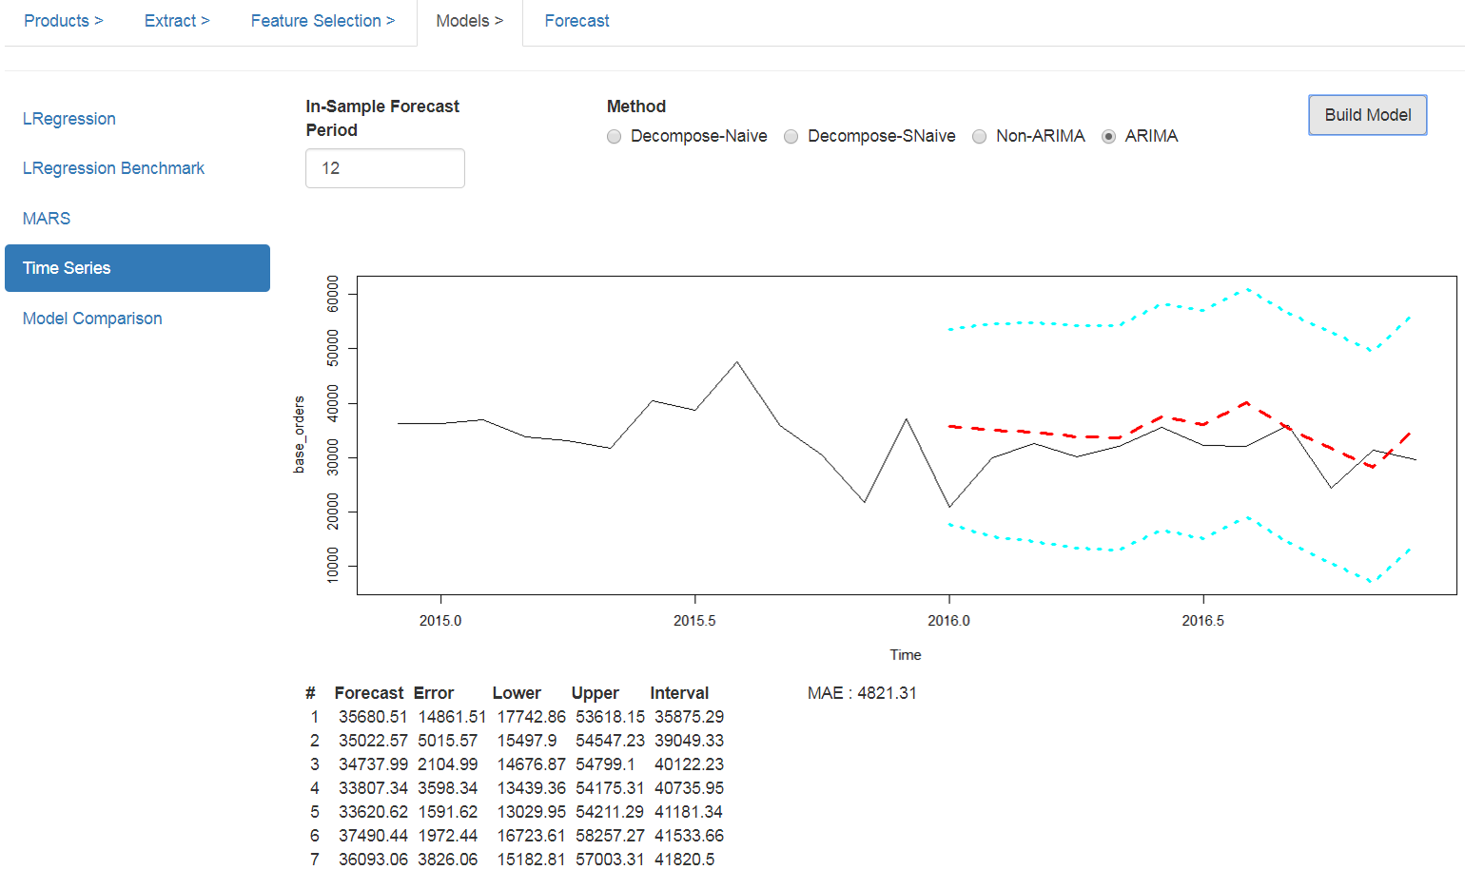
Error metrics for the models
Forecast from
Time Series

Slide 13
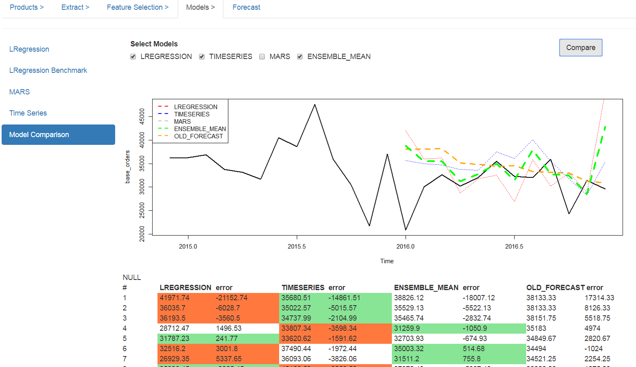
^ Models to plot and ensemble. Make sure the corresponding models have been built
Forecast from
models. Red
Indicates the worst
prediction and green
the best for a month

Slide 14
Step V : Forecast

Slide 15
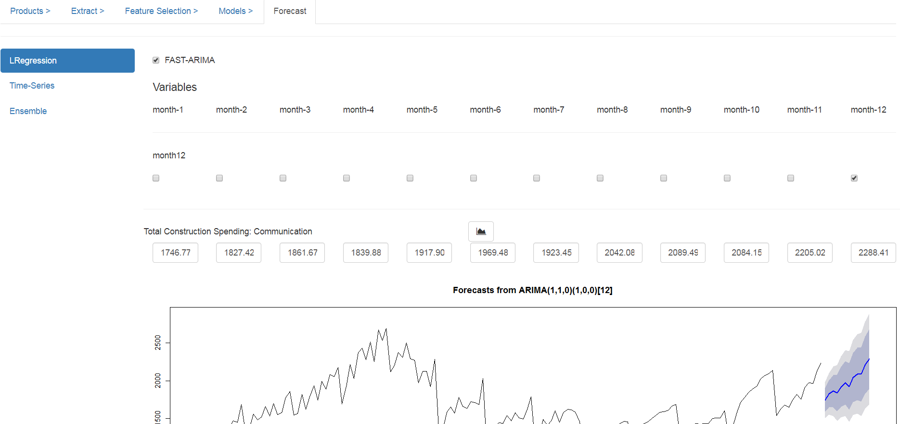
Step #1: For each monthX,
select if the corresponding
month is Xth in a year
Step #2: For each of the continuous
variable, click the button to use
ARIMA for forecasting its values.
If a better reliable source is available,
they can be entered in the corresponding
text box.

Slide 16
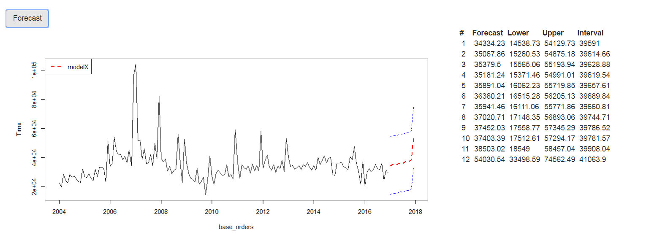
Continuation..
Step #3: Click “Forecast”. The predictions for the next year are shown in the plot and table below
Step #4: Perform the similar operation for all other available models

Slide 17
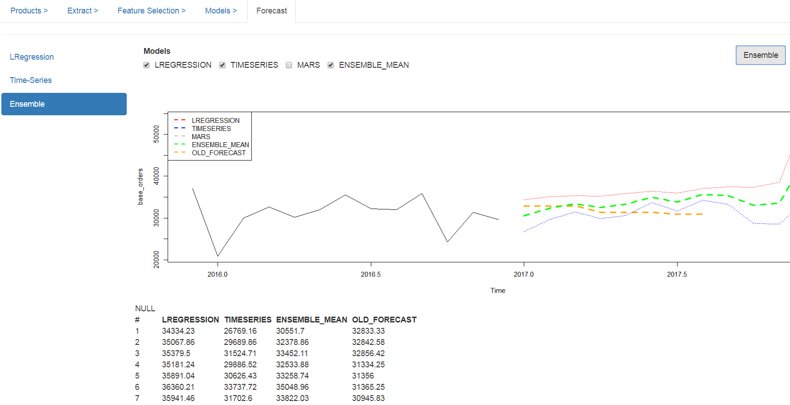
^ Select the models to plot and ensemble. Make sure the corresponding models have been built.
Forecasts for
each month

